Slide 1

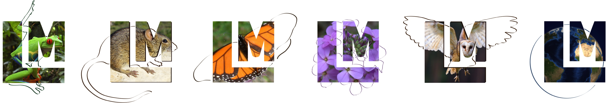
PRAGMA 27 Student Challenge:
Install Lifemapper Components
Aimee Stewart (KU) astewart@ku.edu
Nadya Williams (UCSD) nadya@sdsc.edu

Slide 2




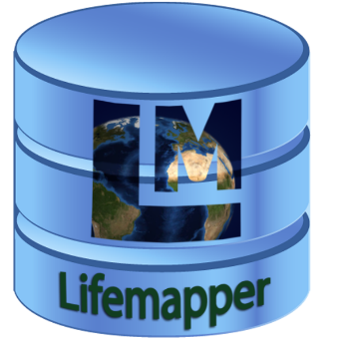
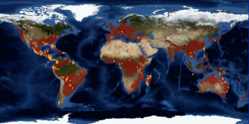
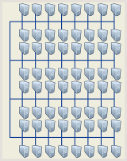
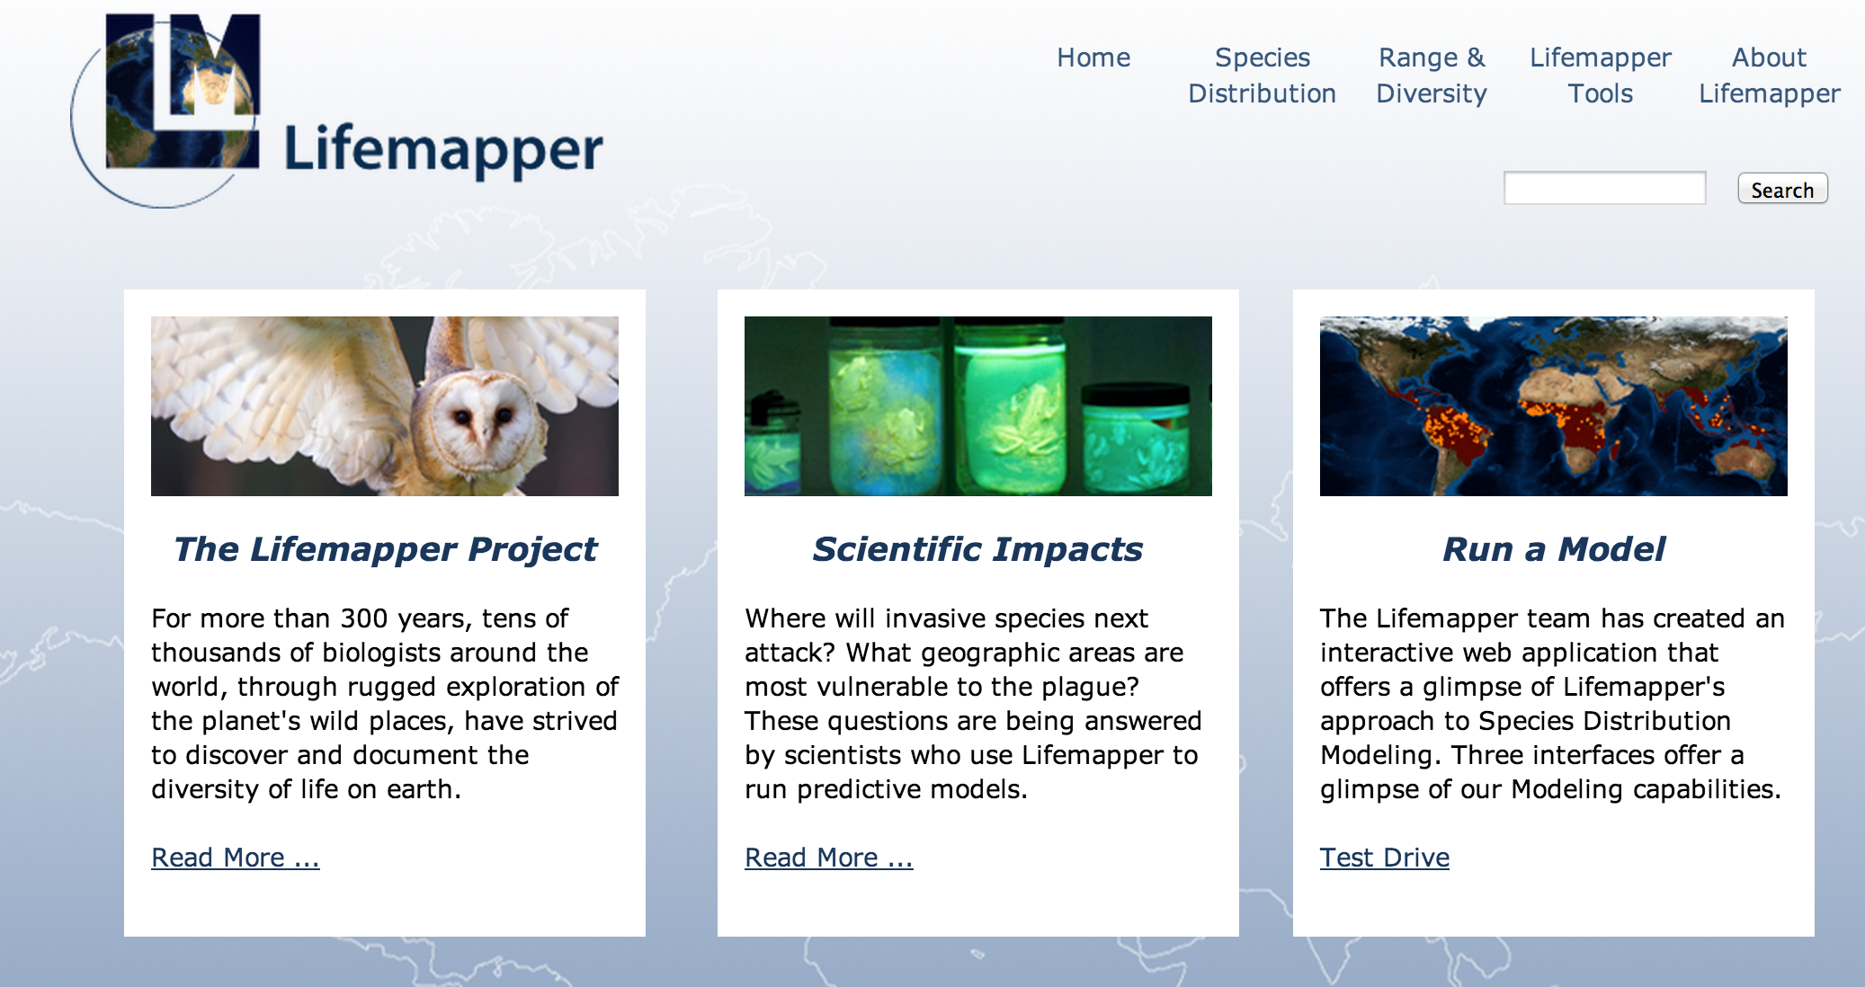
PRAGMA 27 Student Challenge
Lifemapper server cluster
LmDbServer
Lifemapper is:
Software infrastructure for biodiversity research
Previously tied to Kansas installation and data
Goal: Deployable infrastructure
Process: Create automated install and configure process
Methods:
Use Rocks Cluster Management System to leverage ‘roll’ technology
Add configuration files and scripts for localization
Bootstrap database and metadata seeding
Your Challenge:
Install VirtualBox on laptop
Install and configure Lifemapper components (Servers only)
Start data pipeline
Examine scripts and logfiles
To understand virtualization and deployment processes
To identify areas for improvement
Pipeline
Species
Climate
Maps & Models
Data updater
Job tracker
Predicted habitat
PAM assembly
LmCompute
Cluster
LmWebServer
LmSDM
Website
REST Web Services
LmRAD
Submit job
Request data
Post result
Notes:
LM is a multi-component system; each component is designed to communicate with the others, but work independently.
The goal is to have multiple instances of one or more components running for individuals who need Lifemapper.
The components include
LmDbServer – the Data and Management Component
LmCompute – the Compute Component
The Web Component exposes as web services
Data, metadata, and research tools for users
Jobs for the Compute component
The Client Component (not shown) includes the
Website, python application, and a QGIS plugin

Slide 3
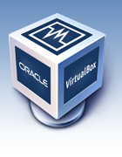
Virtualization Technologies
VirtualBox
Runs on Linux, Windows, OSX
Ideal for laptops but instance size is limited by hardware
Advantages in VBE
Can special-purpose or short-lived instance
Ideal for:
Testing
Field work (with no network connection)
Teaching tool
Notes:
VirtualBox is a powerful x86 and AMD64/Intel64 virtualization product
Free and Open Source Software
runs on Windows, Linux, Macintosh, and Solaris hosts
Supports many guest operating systems

Slide 4
Virtual Box Image
Install
VBox instance
with Rocks frontend
Add
2 LM components
Bootstrap
database
LmDbServer
LmWebServer
LmDbServer
LmWebServer
Notes:
Then start pipeline

Slide 5
Lifemapper in VirtualBox on a laptop
Import VM
Start VM
Install roll
Bootstrap
database
5 min
3 min
15 min
50 min
Setup
Use
Challenge Steps:
Install VirtualBox, import VM, start VM
Install lifemapper-server roll
Bootstrap database
Run data pipeline application
Examine process
Notes:
We’ve reduced the overhead of bringing up Lifemapper components so it can be done repeatedly to
Test robustness of code
Test alternate hardware
Test scalability
Test different input data
Demonstrate the process including application refactoring
Benefit from your suggestions!

Slide 6


Acknowledgements
This work is funded in part by National Science Foundation and NASA grants
PRAGMA
US NSF 1234953
Rocks
US NSF OCI-1032778
US NSF OCI-0721623
Lifemapper
US NSF BIO/ABI 1356732
US NASA NNX12AF45A
USGS CESU #G14AC00285
Notes:
Also
USGS CESU #G14AC00285
These are all complete?
US NSF BIO/DBI 0851290
US NSF EPSCoR 0553722
US NSF EPSCoR 0919443
US NSF EHR/DRL 0918590
US NSF OCI/CI-TEAM 0753336

Slide 7
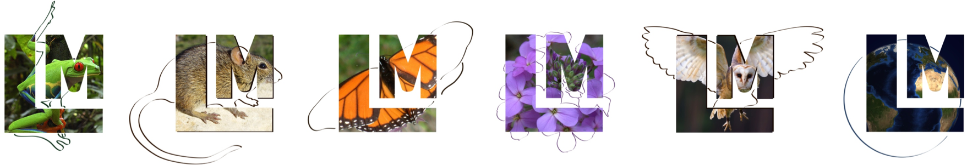
Questions?
Aimee Stewart (KU) astewart@ku.edu
Nadya Williams (UCSD) nadya@sdsc.edu
Lifemapper
http://lifemapper.org
https://github.com/lifemapper/
Rocks
http://www.rocksclusters.org
Pragmagrid GitHub
https://github.com/pragmagrid/lifemapper
https://github.com/pragmagrid/lifemapper-server

